Slide 1
My daily routine
9th Grade

Slide 2
What do you usually do during your week?

Slide 3
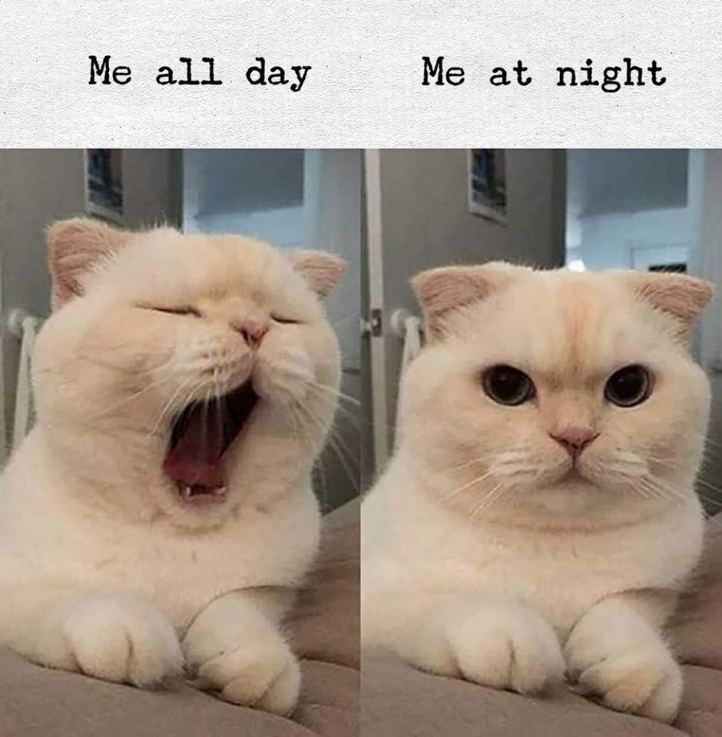
THIS IS ITS DAILY ROUTINE:

Slide 4
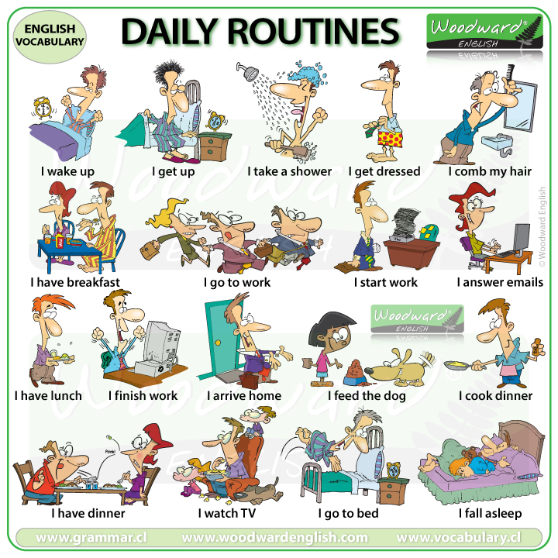
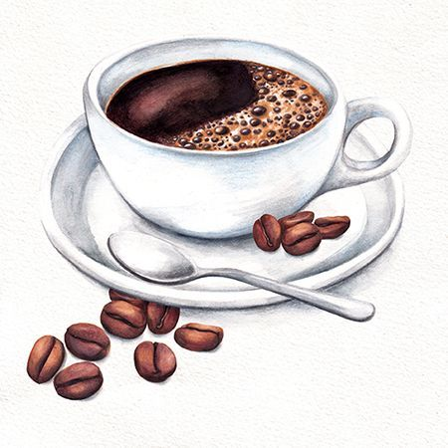
Drink a cup of coffee
What other habits do Colombian people have?

Slide 10
Do you study on Saturdays? Yes I do . I study in the morning.
Do you go swimming in the morning? No, I don’t. I can’t swim.
Does your brother play baseball? Yes, he does. He plays very well.
Does he live in Montería? No, he doesn’t . He lives in New York.

Slide 12
Thanks!

Slide 13
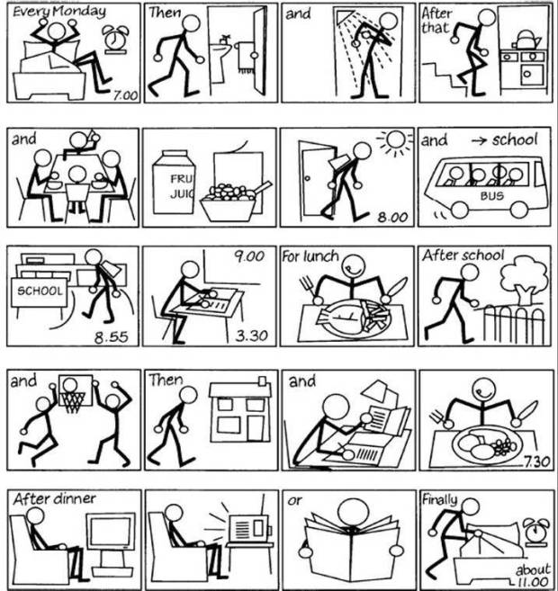
WHAT DOES HE DO DURING HIS DAY?
JULIA’S STORY
https://www.sutori.com/story/my-daily-routine--TMLcPQV74b9gfcRvnAwXtCGq

