Slide 1
Wh-questions
9th grade

Slide 2
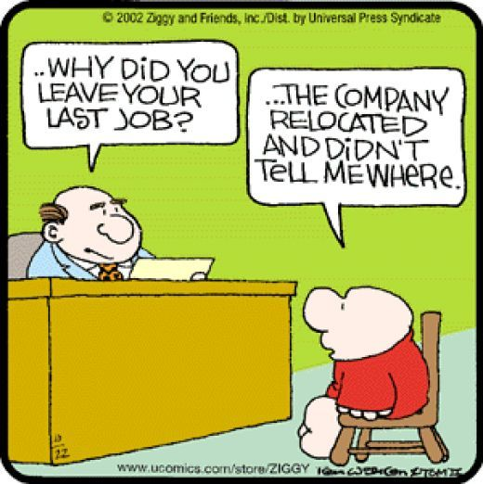

Slide 3
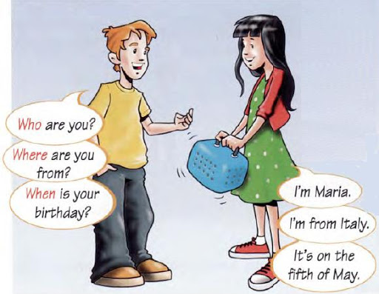

Slide 6
QUESTION BANK:
What’s your name?
Where do you live?
How old are you?
What do you do?
What do you do during your day?
what’s your favorite part of the day? Why?
When do you go to work?
What time do you get up?

Slide 7
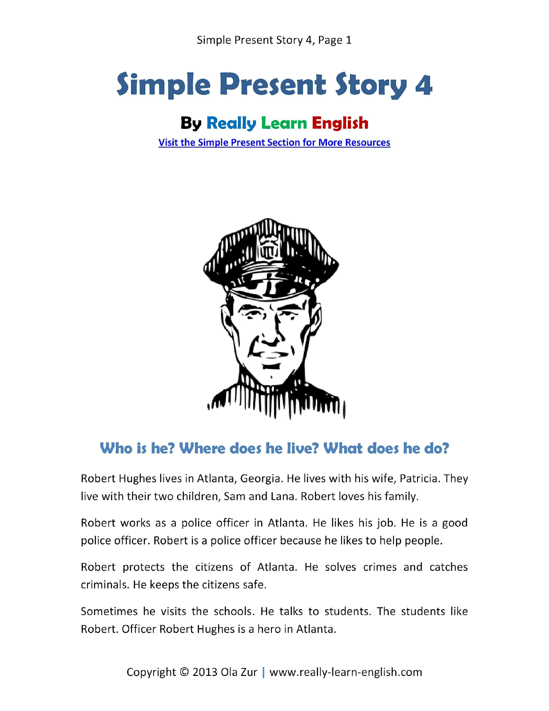

Slide 9
Practice: https://es.liveworksheets.com/worksheets/en/English_as_a_Second_Language_(ESL)/Daily_routines/Daily_Routines_reading_af516790oc

